Slide 1

Performance Evaluation of SDN Controllers
Team Members
Sandhya Arumugam Karunanithy
Disha Dudhal
Mohamed Yilmaz Ibrahim
Tanmaya Udupa
Sharath Chandra

Slide 2
Increased use of SDNs.
Many controllers out there with no definite comparisons.
Many applications being developed by academia/industry that use SDN controllers.
Need for high performance controller in Networking industry, data centers and research.
Motivation
Notes:
Software defined networks have gained popularity in recent times. One of the core components of the SDN architecture is the controller which is responsible for all the network or data plane management. SDNs are currently used in industry, data centers, and research. As new requirements emerged for various applications, there was an increase in the development of controllers to meet these requirements. This made it necessary to compare these controllers on both a qualitative and quantitative level.
For our project we have compared 5 popular controllers - RYU, Opendaylight, Floodlight, ONOS and POX.

Slide 3
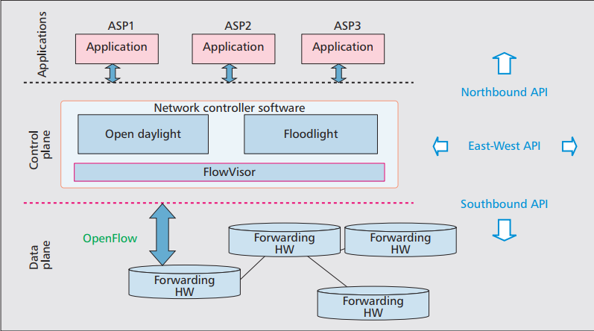
SDN Controllers
“Brains” of the network
Centrally defined policies that allow automated network management
Communicates with the application via the northbound interface and the network devices via the southbound interfaces.
https://www.researchgate.net/figure/SDN-Controller-In-this-there-are-four-bounds-in-this-SDN-and-they-are1-Northbound-API_fig1_329735894
Notes:
An SDN controller is the fundamental and core element of SDN architecture. They are called the brains of the network since they have a complete view of the underlying network topology, network devices and how the traffic flows in the network. SDN controllers allow us to define policies that help in automated network management. Based on the policies defined by the network operators, the data plane can be programmed to perform a particular function through protocols like openflow.

Slide 4
Qualitative Comparison
Controller | Programming language | Architecture | Multithreading | Platforms
Ryu | Python | Centralised | Yes | Linux,MacOS
Opendaylight | Java | Distributed Flat | Yes | Linux, MacOS, Windows
ONOS | Java | Distributed Flat | Yes | Linux, MacOS, windows
Floodlight | Java | Centralized | Yes | Linux, MacOS , Windows
POX | Python | Centralized | No | Linux, MacOS, Windows
Notes:
Here are some of the qualitative comparisons that we made across these controllers.
The architecture of an SDN can be centralized or distributed. The centralized architecture controllers like RYU here are used when we have to develop small networks whereas distributed controllers like Opendaylight are used when there are huge networks that span multiple domains. Similarly a controller that does not support threading can only be used for small scale deployments whereas a controller that supports multithreading can be used for industry purposes.

Slide 5
Metrics and benchmarking tools
2-fold method of performance evaluation from controller perspective and node-to-node perspective.
Latency and Throughput metrics defined by Cbench have different meanings in the way the testing is carried out.
Latency and throughput metrics can also mean the total RTT and the actual amount of data being transferred between two nodes.
Notes:
Our performance evaluation was 2 fold. We measured the controllers latency and throughput by using Cbench benchmarking tool.It emulates switches and controls the flows that are sent to the controller. In latency mode, the flows are sent serially. Meaning, each switch sends a flow and waits for the controller to respond. In through put mode all the switches send flows to the controller without waiting for a response from the switch. Next, we also measure the node to node latency, throughput and round trip time by sending traffic from one node to another in the mininet environment.

Slide 6
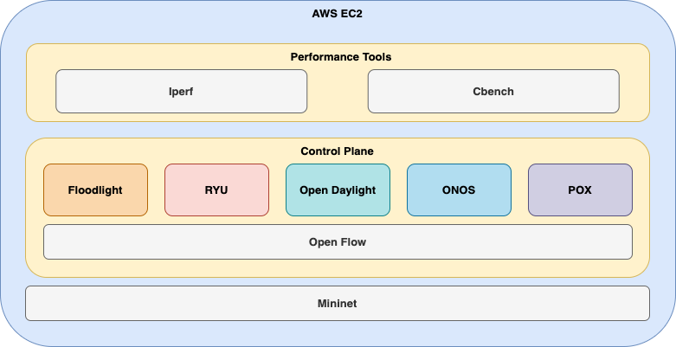
Metrics, benchmarking tools & Experimental Setup
Metrics
Latency
Throughput
RTT (Min/Max/Avg/MDev)
Transfer Size
Bandwidth
Number of Responses / Sec
Jitter
Benchmarking Tools
CBench
IPerf
Setup
VM: Amazon EC2
Instance Type: t2.large
Storage Size: 30 GB
Processor: Intel(R) Xeon(R) CPU E5-2686 v4 @ 2.30GHz
CPUs: 2
Switch Type: L2 Learning switches
Topologies
Single
Linear
Reversed
Tree
Minimal
Notes:
We conducted our experiments in an Amazon EC2 t.large instance with intel Xeon processor and had 2 CPU cores. We used l2 learning switches for our experiments.

Slide 7
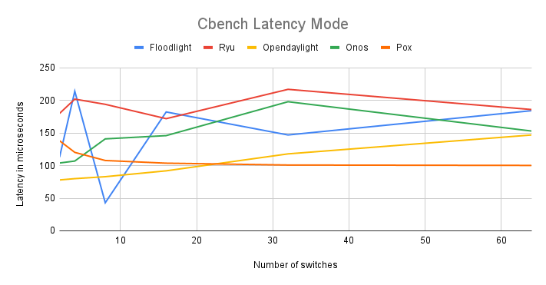
Results and Discussion
Notes:
Discuss the results we obtained along with the graphs.
For this test we kept the number of iterations constant to 10 while we increased the number of switches from 2 to 64.
We observed that POX shows minimal change in latency as the switches increase. However, less latency does not translate to out-right winner as the capabilities of the controller itself must be considered.
For ODL, latency increases fairly as compared with the number of switches.
For some other controllers like RYU, we observed that the latency doesn’t change with an increase in the number of switches.
Cbench latency identifies the communication delay between the controller and the switch. Here every switch is directly connected to the control. In cbench latency mode all the switch send packets to the control in a serial manner and wait for the reply before sending the next packet. The reciprocal of the average number of flows processed by the controller gives the the Cbench latency metric.

Slide 8
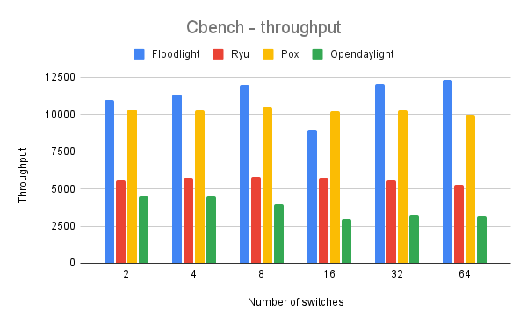
Results and Discussion
Notes:
Discuss the results we obtained along with the graphs.
Cbench Throughput mode: Cbench switch sends as many packets as possible at once and does not wait for a reply.
Ryu and ODL were consistently lowest performers. (Surprising cos they both support multithreaded capabilities.)
Floodlight performed consistently well with around over 10k flows/second

Slide 9
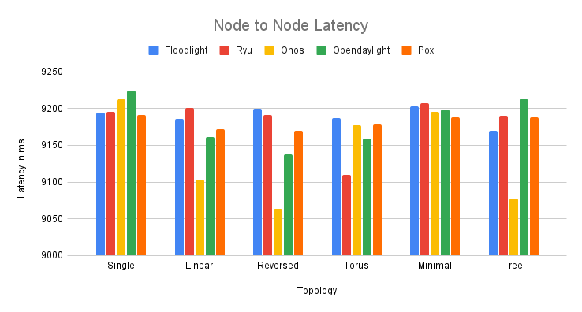
Results and Discussion
Notes:
Discuss the results we obtained along with the graphs.
The time complexity of packet processing at the controller affects the overall performance.
We observed that Floodlight, Pox give consistently gives great performance in terms of latency. This can be attributed to the simpler algorithms that these controllers use, however less complex does not translate to better controller.
Controllers which perform better in latency tests have dynamic packet changing capabilities.

Slide 10
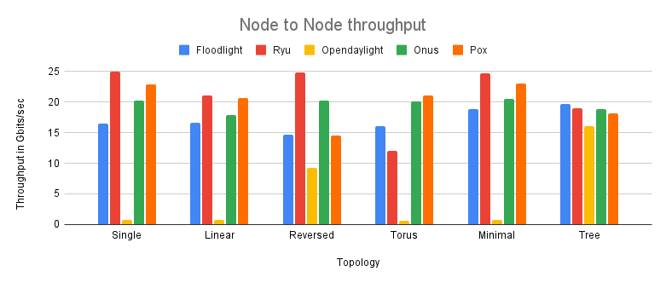
Results and Discussion
Notes:
Discuss the results we obtained along with the graphs.
In terms of Node to Node throughput Ryu was consistently the better performer, with POX and ONOS lacking just a little bit.
For tree topology all the controllers performed fairly the same.
Floodlight gives a consistent performance with very little variation across different topologies.

Slide 11
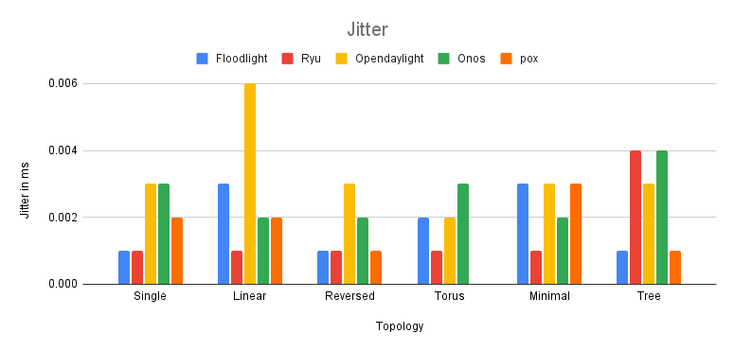
Results and Discussion
Notes:
Discuss the results we obtained along with the graphs.
Jitter: The variation in the delay regarding packet flow between server and client is indicated by jitter. Aka jitter is variation in delay itself
Ryu has the least jitter out of all the controllers under consideration, aka it has a fairly consistent delay.
ODL has fluctuating jitter while ONOS and POX have minimal jitter variation across topologies.
The difference between transmission-time and reception-time indicates the delay.

Slide 12
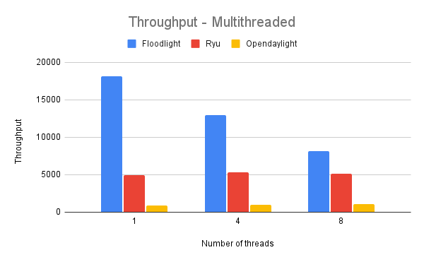
Results and Discussion
Notes:
We also extended our research by testing the effects of multithreading on controller throughput. We observed that ryu and opendaylight have better throughput with increasing number of threads. However, floodlights performance drastically decreases in this case. There is a need for more experimental analysis since this observation deviated from our original hypothesis.

Slide 13
Inferences
Multi-threaded controllers perform significantly better than single-threaded controllers like (POX and RYU).
Topology has an impact on the performance metrics and, efficient handling of switches is characteristic to every controller.
Limitations of evaluation tools directly affects benchmarking. Change in physical resources or compilers may have noticeable impact on the results collected.
Isolating controller performance from its experimental setup is not possible.
Simple controllers are better suited for lightweight tasks. Feature based controllers are better suited for heavy performance tasks.
Notes:
Placement of the controller in physical topologies greatly affects the evaluation of performance parameters. We plan to include our studies on different datacenter topologies like Fat and Short trees with many devices.
Limitations of evaluation tools directly affects benchmarking. Cbench uses a fixed number of emulated switches due to available hardware and change in physical resources or compilers may have noticeable impact on the results collected.
Isolating the performance of a controller from its results is not possible since the features of the tools available greatly impact the performance of the controller in a given topology.
Hence comparing capabilities of different controllers is a difficult task
Simple controllers are better suited for configuration based tasks. Feature based controllers are better suited for Performance based tasks.

Slide 14
Future Work and Reflections
With this experiment, we could evaluate the performance of the five most common SDN controllers. We analyzed the controllers and obtained the results across a different range of test scenarios (topologies, network load)
Extend the work to other SDN controllers like Trema and TinySDN
Make use of other performance benchmarking tools like PktBlaster and Browbeat to calculate the other metrics as well.
Extend our work on specific use-cases like Datacenter, WAN’s and IOT
Notes:
We would like to extend our research to other controklers like trema and TinySDN using more benchmarking tools like OFnet and pktblaster. Using tools like OFnet would allow us to compare custom and complex topologies.

Slide 15
THANK YOU

